Slide 1


HOME CREDIT DEFAULT RISK
GROUP NAME: DOM DOM
INSTRUCTOR: Ph.D DINH THUY TIEN

Slide 2


CORE TEAM MEMBER
DO HOANG ANH
VUONG HOANG GIANG
A44498
A44526

Slide 3

OVERVIEW

Slide 4



1
MISSION
Identify key features
Build predictive models
TARGET
2
STAKEHOLDERS
Executive Team
Relevant departments
3
GOALS
AUC > 0.7
Precision > 0.7

Slide 5



SCOPE
AGE
EXISTING CUSTOMERS
CASH LOANS
Focus on customers aged 28 - 65, as this is the most common age range for loan borrowers.
Select only customers who have had a previous loan with Home Credit.
Select only customers using cash loans, as this is the most common loan type.

Slide 6




AGENDA
1, EXPLANATION
2, DATA PREPARATION
What is Home Credit ?
What is the main product ?
How does Home Credit work?
What is the mission?
Business problem
Overview Dataset
Pre-processing data
Create new features
Feature selection
3, SOLUTION
4, APPLICATION
Model selection
Prediction variables
Choose the best cut-off threshold
Result & Evaluation
Advantages for business
Criteria
Mini – App
Review
Expansion

Slide 7

EXPLANATION

Slide 8

WHAT IS HOME CREDIT ?
Home Credit is a financial institution specializing in offering loans to individuals with limited or restricted access to traditional banking services.
WHAT IS THE MAIN PRODUCT ?
POS CASH
INSTALLMENT
CREDIT CARD

Slide 9




HOW DOES HOME CREDIT WORK?
Receive application
Review
&
Evaluation
Disburse
Monitors
➤
➤
➤
WHAT IS THE MISSION ?
Reduce the rate of financial loss from customers who are facing difficulties
Mitigating risk while maintaining business growth
Build a model to predict if customers will struggle with loan repayment

Slide 10



BUSINESS PROBLEM
HIGH RISK
TIME-CONSUMING
INCONSISTENT DATA
Insufficient credit history for many customers makes accurate risk assessment challenging.
Fragmented and disorganized customer records across different sources slow down processes.
Information scattered across multiple platforms leads to difficulties in ensuring data uniformity and reliability.

Slide 11

DATA PREPARATION

Slide 12
OVERVIEW DATASET
MERGE DATA
APPLICATION_TRAIN
Customer demographic and loan application data
Rows: 122
Columns: 307221
Rows: 38
Columns: 264668
PREVIOUS_APPLICATION
Customer loans history at Home Credit
Rows: 37
Columns: 1670214

Slide 13



PRE-PROCESSING
DATA TYPE
MISSING VALUES
DUPLICATES
Ensuring correct data types (numerical/categorical) avoids errors in model training.
-
Imputation handles gaps in data to maintain accuracy and integrity.
Removing duplicates improves dataset quality and model reliability.

Slide 14
CREATE NEW FEARTURES
DAYS_BIRTH
AGE
Negative value ( - )
Calculated by days
Positive value ( + )
Calculated by years
PREVIOUS_APPLICATION
AMT_ANNUITY
AMT_APPLICATION
AMT_DOWN_PAYMENT
AMT_GOODS_PRICE
CNT_PAYMENT
RATE_DOWN_PAYMENT
SUM
MEAN

Slide 15

SOLUTION

Slide 16
High
Logistic Regression
Decision Tree
MODEL SELECTION
Interpretability
K-Neareast Neighbors
(KNN)
Random Forest
Poor
Poor
High
Implementability

Slide 17
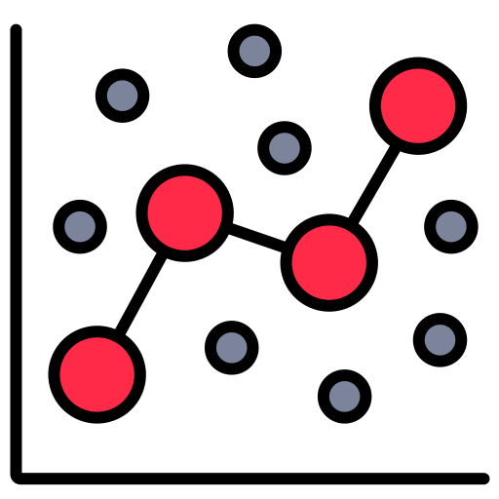
PREDICTION MODEL
INPUT VARIABLES
LOGISTIC MODEL
OUTPUT
Having trouble paying debt?
YES
SELECTED FEARTURES
NO

Slide 18
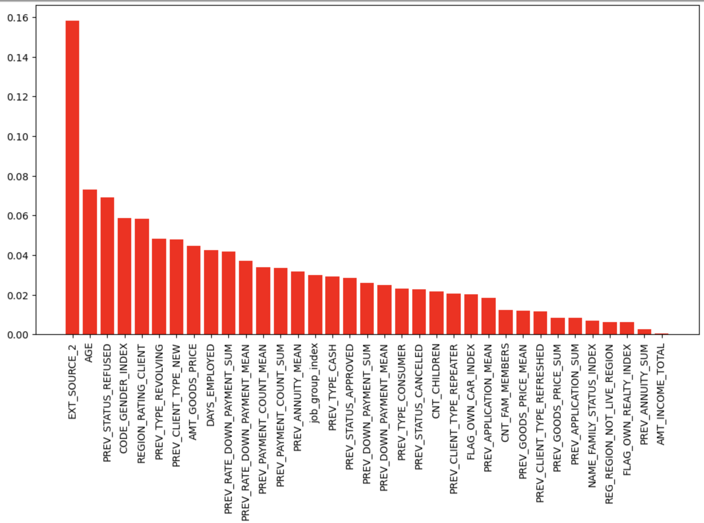
MOST IMPORTANT FEATURES
SELECTED FEARTURES

Slide 19
FEATURES SELECTION
AGE
PREV_STATUS_
REFUSED
CODE_GENDER_VEC
REGION_RATING_
CLIENT
PREV_TYPE_
REVOLVING
PREV_CLIENT_TYPE_NEW
AMT_GOODS_PRICE
DAYS_EMPLOYED
PREV_RATE_DOWN_
PAYMENT_SUM
PREV_RATE_DOWN_
PAYMENT_MEAN
Age of the customers
Customer gender as a vector
Evaluate the area where customers live
Previous loans had revolving contracts
Price of product customer want to buy
New customer in previous loan application
Total days of customer experience
Total customer prepayment ratio on previous loans
Average customer prepayment ratio on previous loans
Customer's previous loan applications were rejected
EXT_SOURCE_2
PREV_PAYMENT_
COUNT_SUM
PREV_PAYMENT_
COUNT_MEAN
PREV_ANNUITY_
MEAN
job_group_vec
PREV_TYPE_CASH
PREV_STATUS_
APPROVED
PREV_DOWN_
PAYMENT_SUM
PREV_DOWN_
PAYMENT_MEAN
PREV_TYPE_
CONSUMER
Credit score from others
Average number of customer prepayments on previous loans
Average customer installment amount on previous loans
Customer work group as a vector
Previous loans with approved status
Cash loans type in previous loans
Total prepayments on previous loans
Average prepayments on previous loans
Type of customer in previous loan
Total number of customer prepayments on previous loans

Slide 20
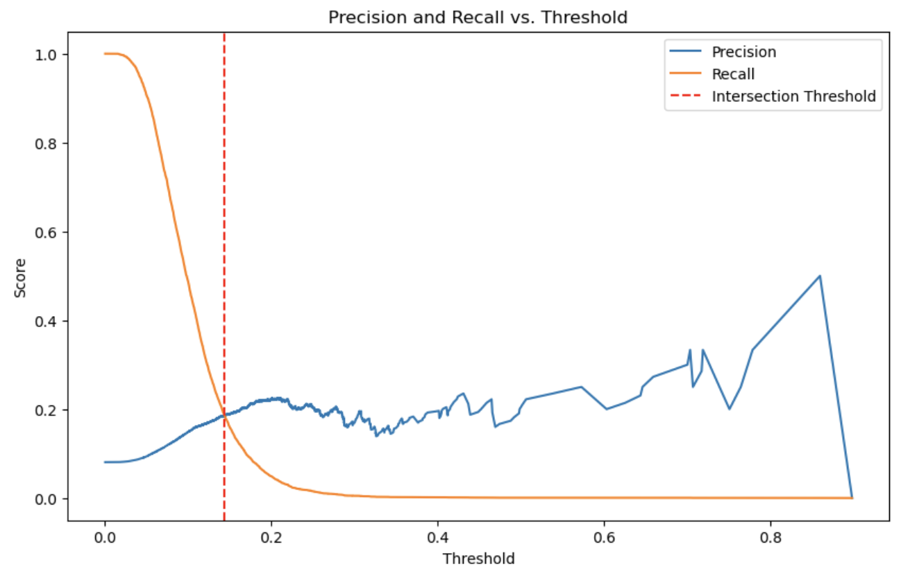
CHOOSE THE BEST THRESHOLD
Threshold: 0.162
Precision: 0.88
AUC: 0.703

Slide 21
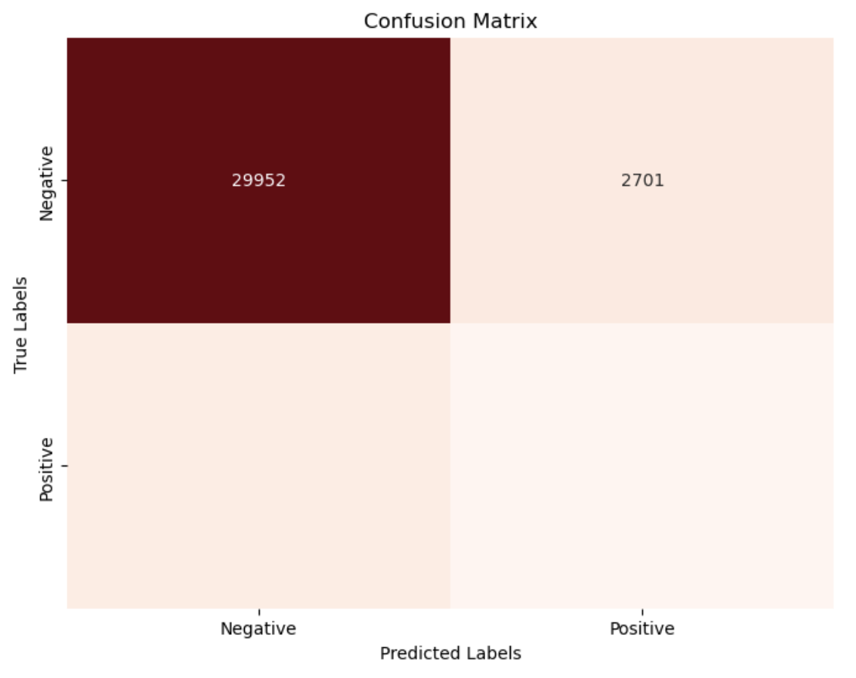
BUSINESS VALUE
=> Increase the ability to predict customers who are facing difficulty by 27%
ADVANTAGE
62748
2310
High Precision:The model is accurate when predicting difficulties
DISADVANTAGE
4776
864
Low Recall: Indicating the model misses many actual cases of customers in difficulty

Slide 22

APPLICATION

Slide 23
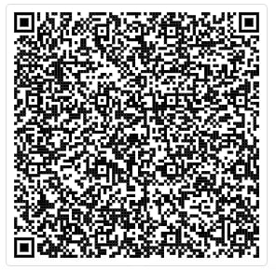




CRITERIA
EASY TO UNDERSTAND
HIGH
PRECISION
MINI APP
https://s.pro.vn/FMyl
HIGH APPLICABILITY
EASY TO UPDATE

Slide 24



EXPANSION
CONVERT TO STRING
BETTER INTERRFACE
COMPLETE APP
Implement functionality to convert relevant model outputs or inputs into string format for enhanced compatibility and data handling
Develop a more user-friendly interface to streamline interactions with the model, improving usability and accessibility
Including all variables allows the model and using additional models to improving its accuracy and predictive power

Slide 25
REFERENCE SOURCE
https://www.kaggle.com/code/kmanojus/classification-regression-problem
https://www.kaggle.com/code/gpreda/home-credit-default-risk-extensive-eda/notebook
https://www.kaggle.com/code/willkoehrsen/start-here-a-gentle-introduction
https://www.kaggle.com/code/phamdinhkhanh/home-credit-default-risk
https://www.kaggle.com/competitions/home-credit-default-risk/discussion/63032

Slide 26

THANK YOU

